Slide 1
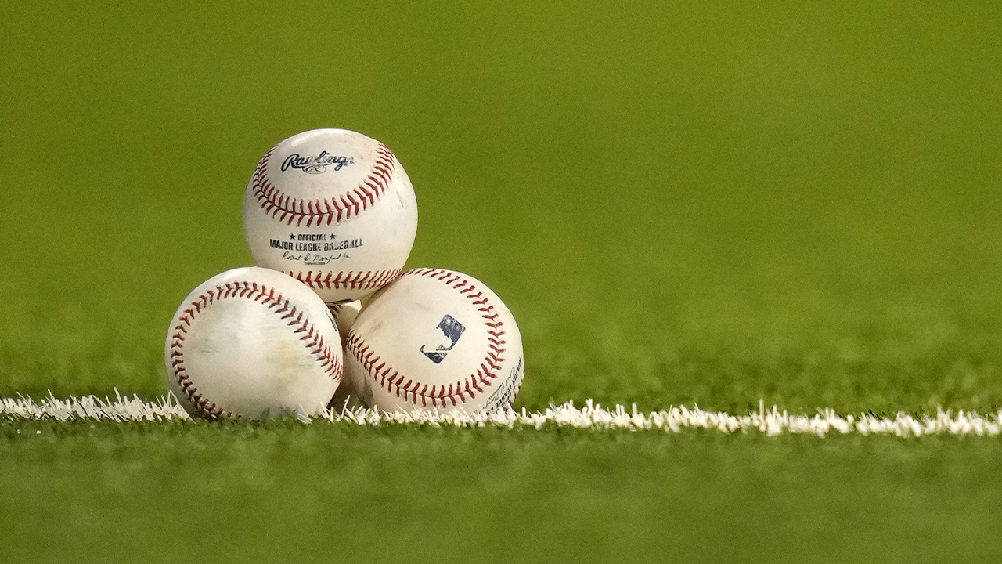
The Economic and Player Effects of Covid-19 on MLB Baseball
Anthony Palacios
Sergio Basurto
Osamu Alder
Michael Diaz

Slide 2
Project Explained
Through the years of 2019 – 2021, we’ll be presenting each team’s league standing before, during, and throughout the recovery of 2020. Individual player data will also be used to analyze changes.
In a review of our data, we’ll have the ability to depict which teams were affected most by the COVID-shortened season, and how it also effected players’ performance if any.
Please keep in mind how our data can be of use to any sports enthusiasts who would like to crunch stats and analyze the contributions to each team’s success throughout the years.

Slide 3

Motivational Question’s
1
4
Which teams were affected the most during covid-19 financially? Were small-market teams affected more?
Were teams able to get back on their feet, financially, after the pandemic? How did this affect attendance across the league?
2
Which of the top players’ performance suffered a huge decline throughout the pandemic? Which player’s overperformed during the pandemic?
3
Were any of the teams dropped in rank because of Covid – 19? Were any teams boosted?

Slide 4
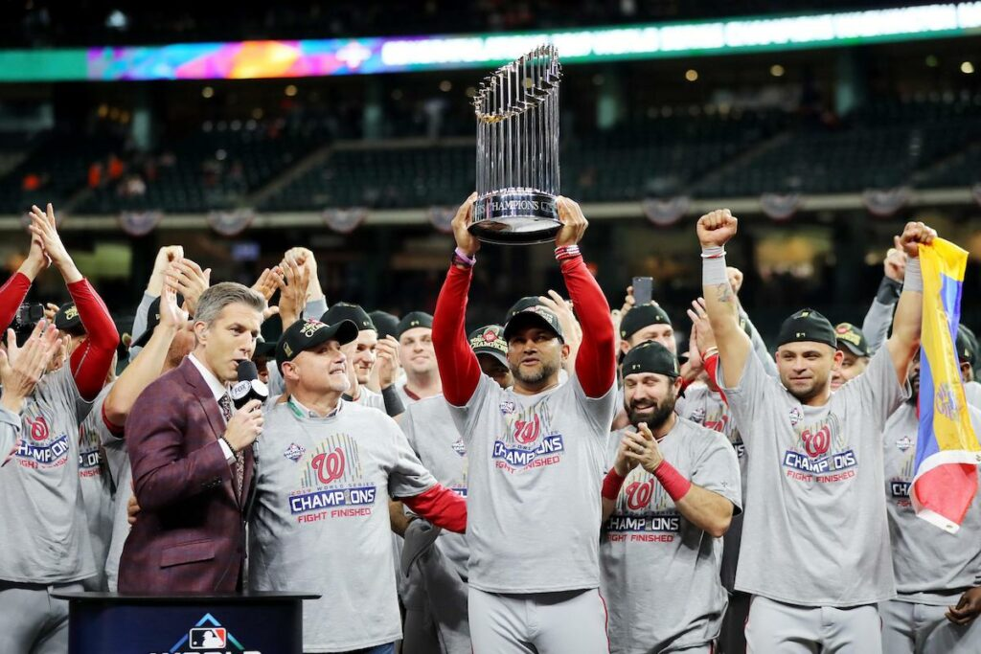
League Before Covid (2019)
2019 showed that high-valued players succeeded the most with most Top-10 players being entrenched stars. Their individual success led to team success.

Slide 5
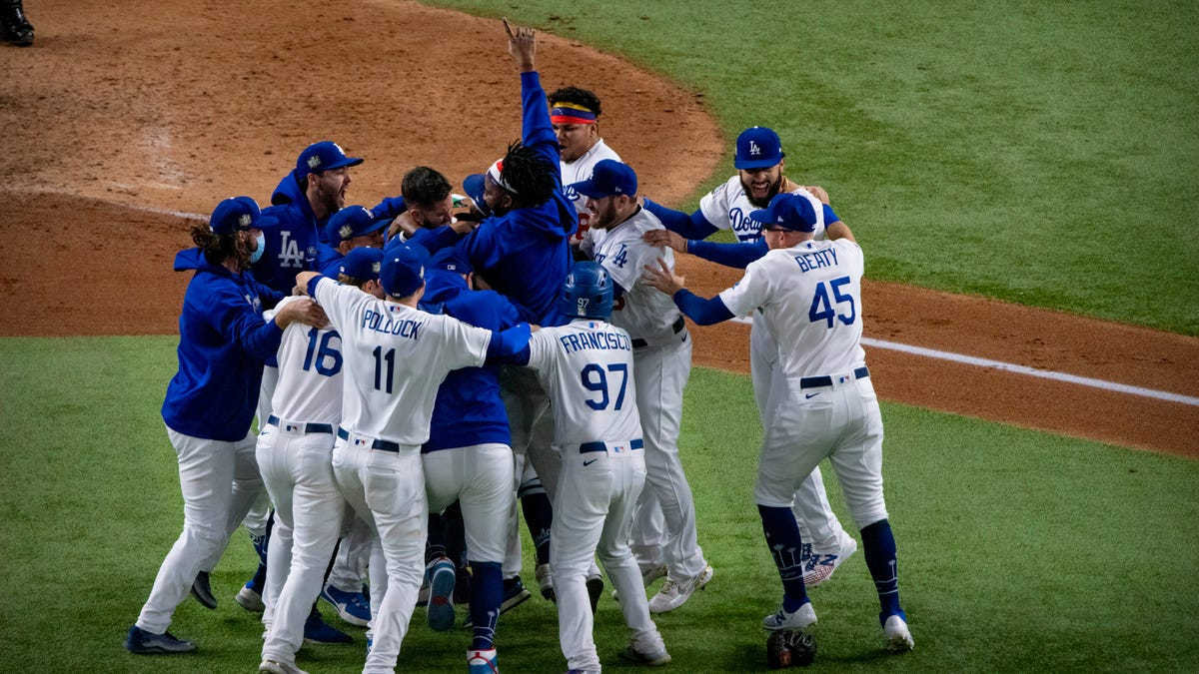
League During Covid (2020)
The COVID shortened season allowed for undervalued players to shine. Players such as Luke Voit and AJ Pollock who under normal circumstances would not be as successful finished with Top-11 seasons-their best finishes ever.

Slide 6
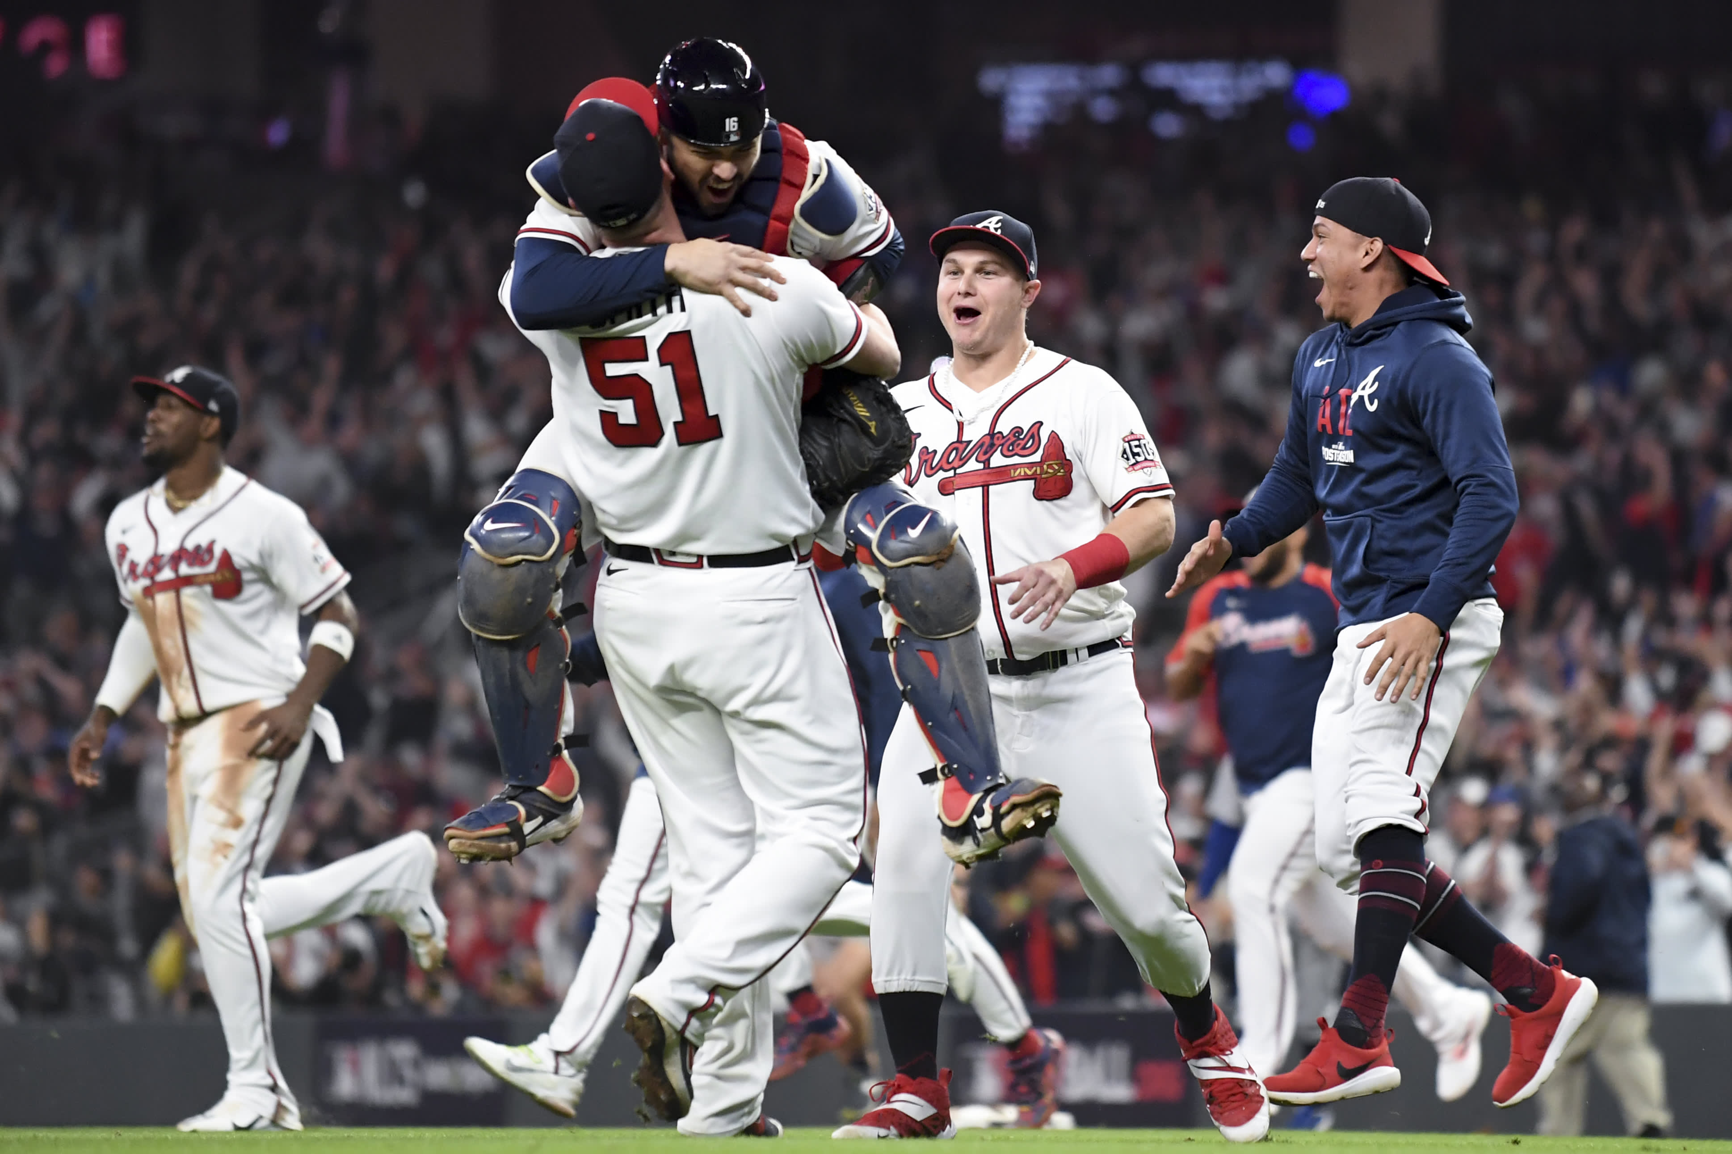
League After Covid (2021)
Due to statistical regression and progression, star players who did not have good 2020 seasons came back with stellar 2021 seasons and the stats reflected this. This can also be reflected through the teams that made the postseason.

Slide 7
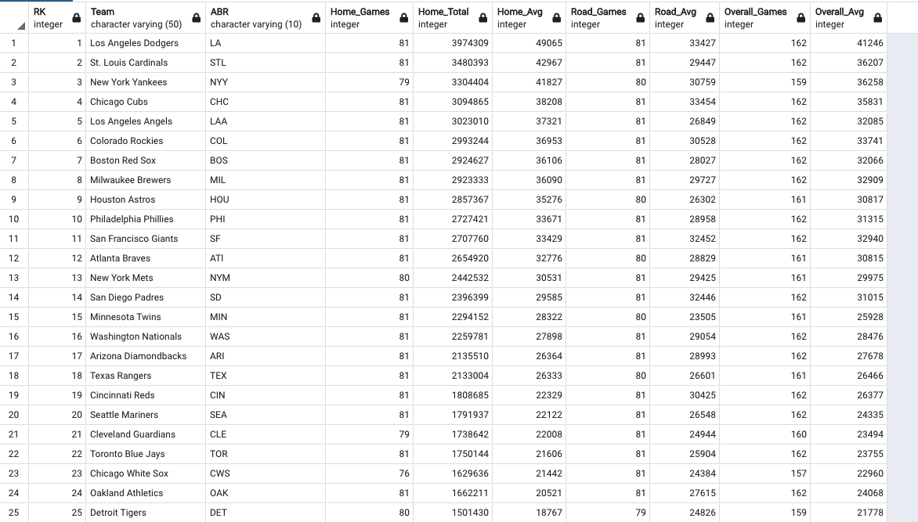
Attendance: Before and After COVID
2019: The top-25 teams displayed here show high averages of major league attendance with the top-12 teams all posting averages above 30k per game.

Slide 8
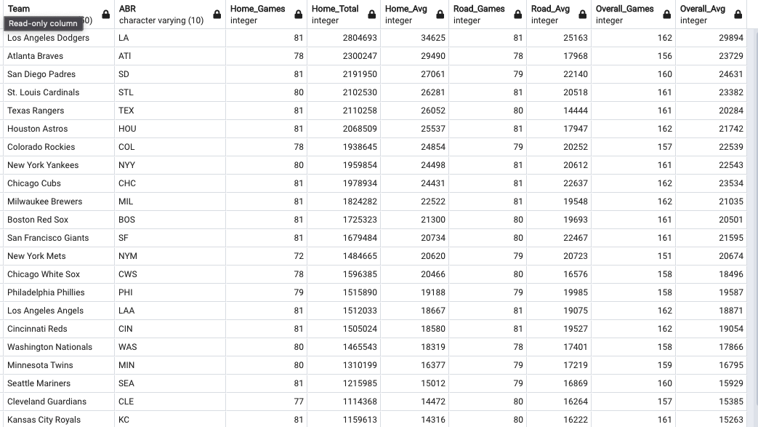
Attendance: Before and After COVID cont.
2021:
2021: League averages in 2019 had 12 teams above 30k per game, and as shown here COVID’s most drastic effect on the game can be seen here. Even the most popular team (the LA Dodgers) did not see attendance above 30k. This can be due to regulatory measures and a decline in popularity.

Slide 9
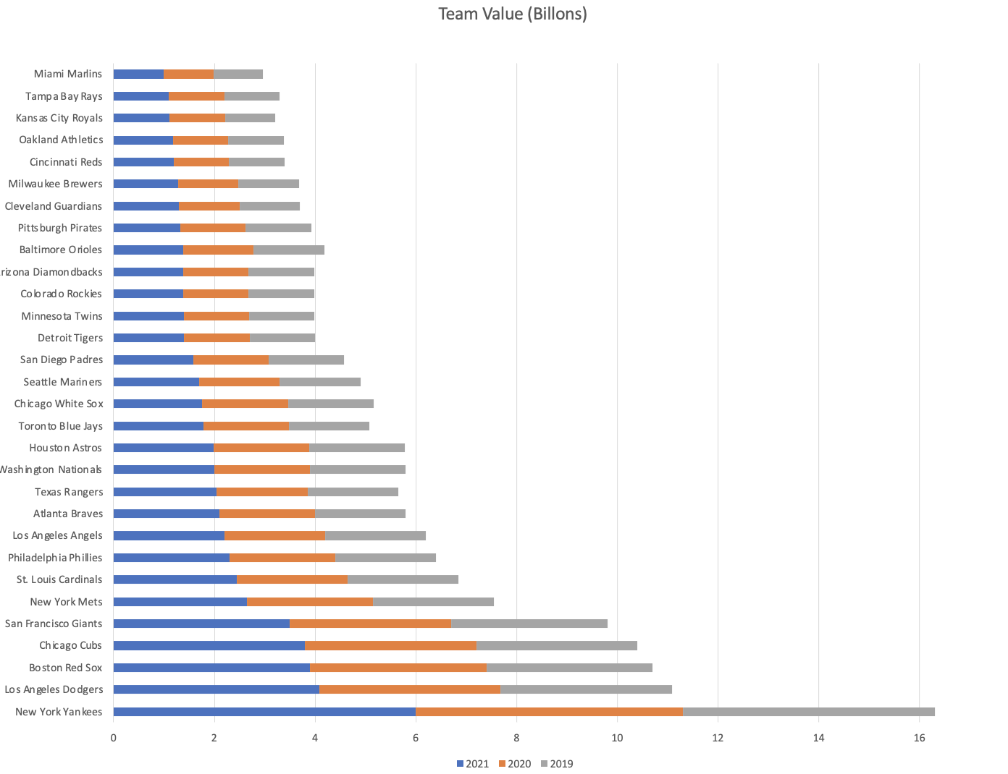
Financial Comparison
“”
“”
While COVID had an initial adverse affect on most team’s financial standings, our data showed a growing separation between the the top-10 richest teams and the rest of the league
Smaller market teams were significantly more post-covid while larger market teams actually grew financially

Slide 10
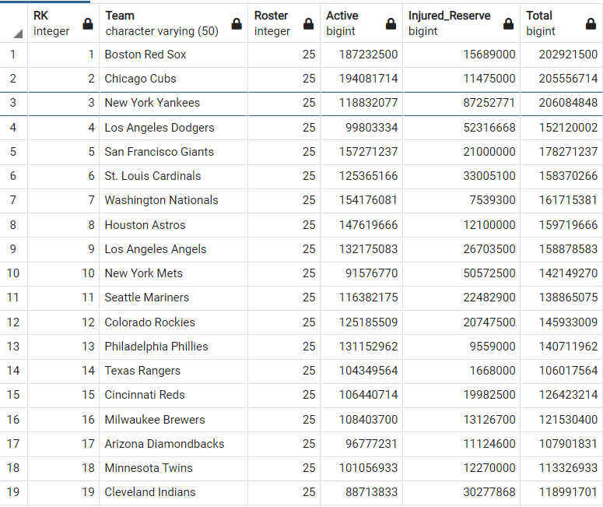
League’s payroll before Covid 2019: The top-19 teams displayed here show high averages of major league payroll with the top-12 teams

Slide 11
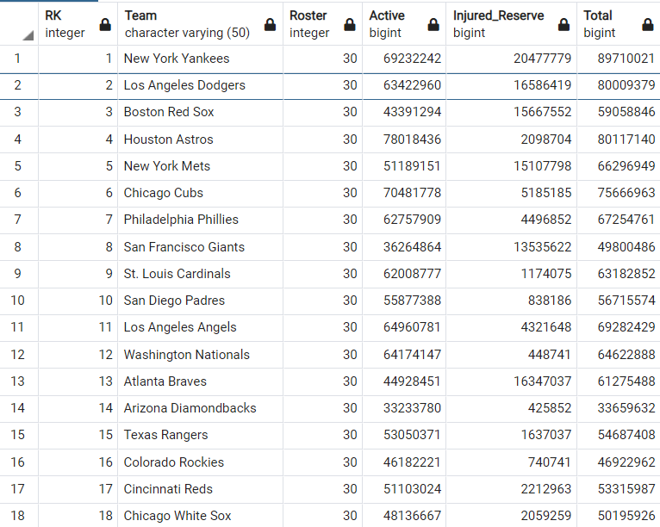
League’s Payroll during Covid 2020: The top 18 teams displayed here show significant decrease as to the previous year

Slide 12
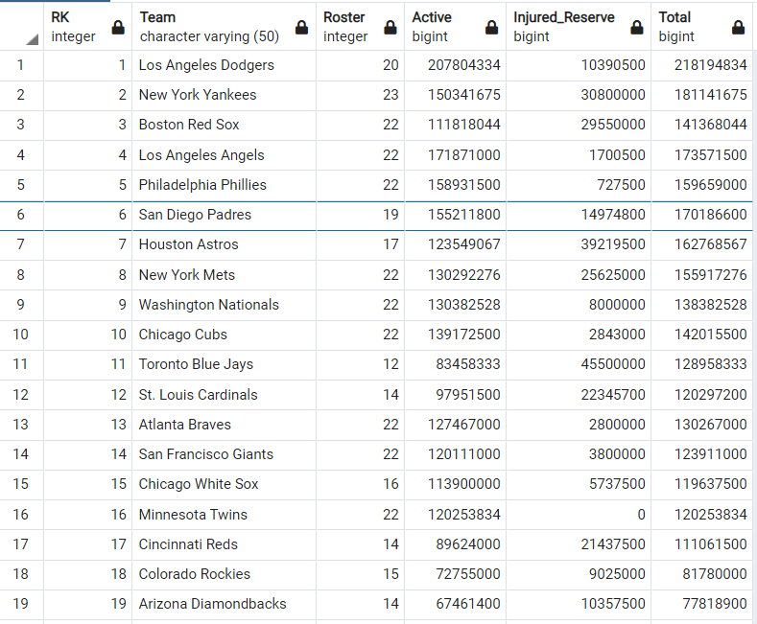
League’s Payroll after Covid 2021: The top 19 teams displayed here show quite the recovery form the pandemic. Safe to say most of them were able to get back where they started.

Slide 13

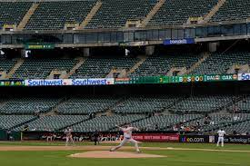
Project Summary
Our analysis of data on attendance, financial comparisons, and individual player performance allows us to paint a clear picture on the on-field effects of COVID-19.
“”
“”
The biggest change on baseball between the 2019 and 2021 seasons had to do with the large decrease in league-wide attendance. From the largest-market teams to the smallest-market teams, average league attendance significantly dipped by thousands.

Slide 14
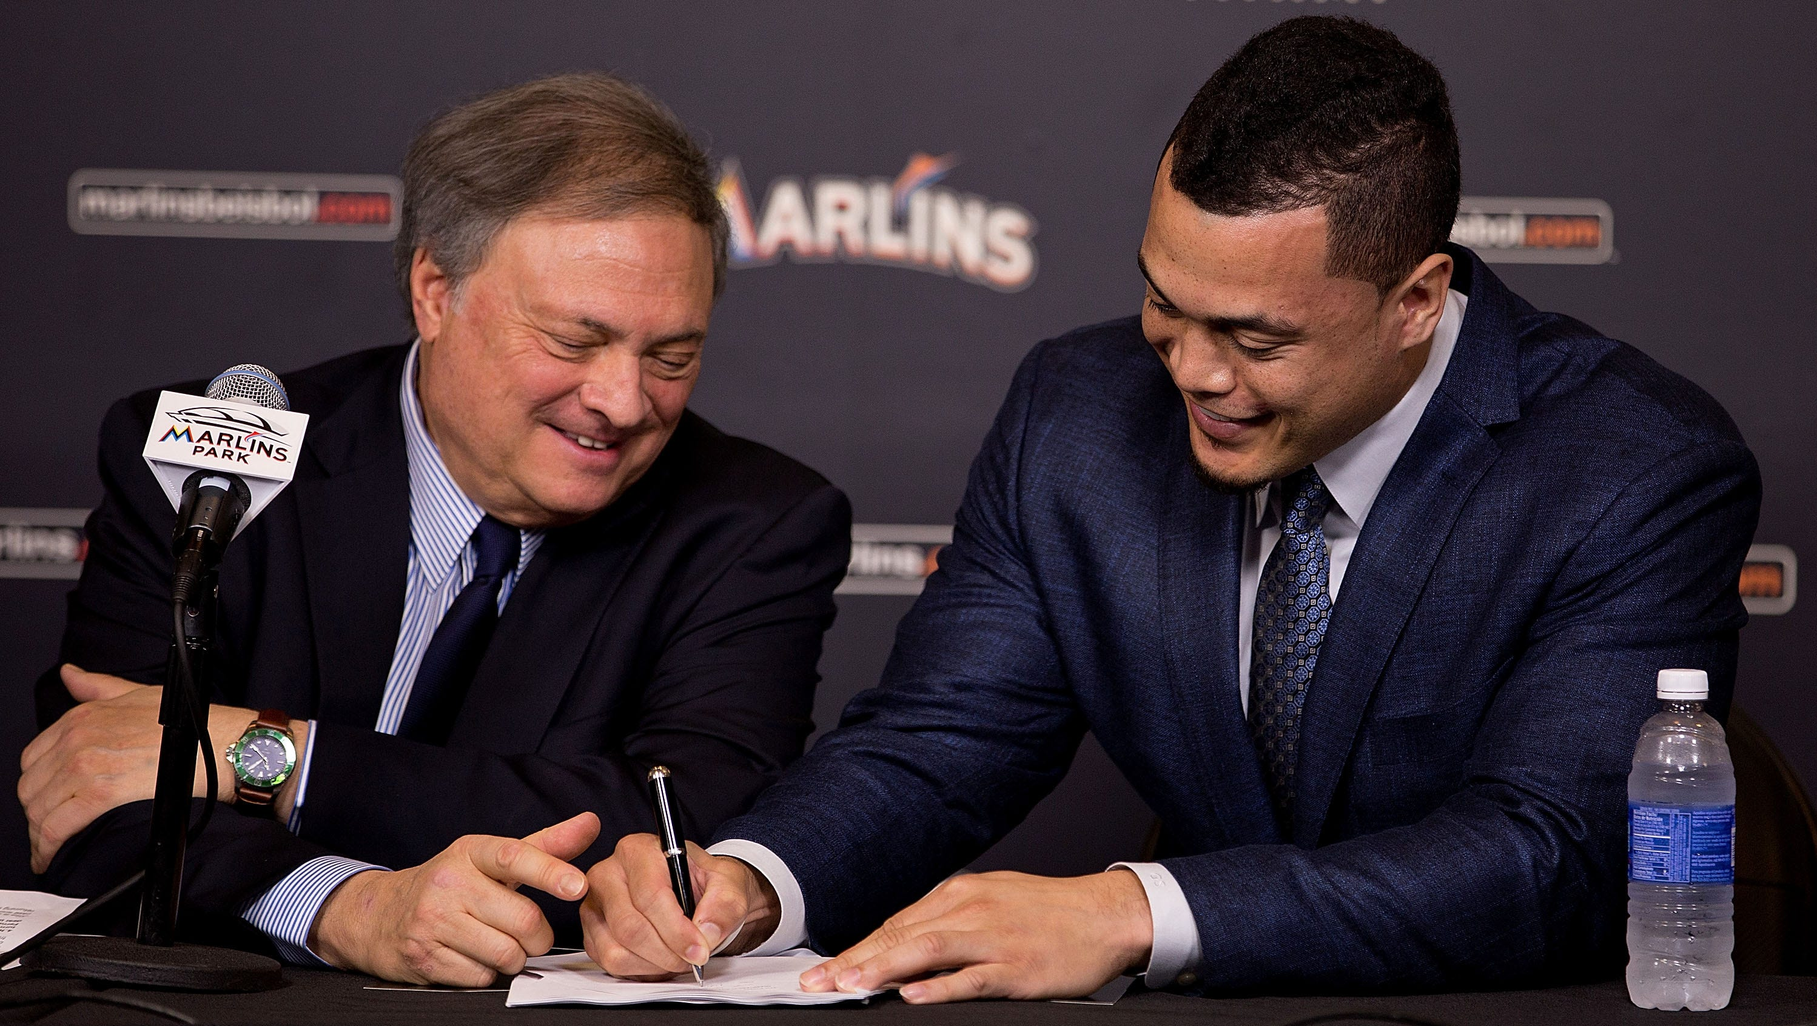

Project Summary cont.
Although league-wide attendance affected all 30 MLB ball clubs, financial standings did not reflect this trend. Rather, the COVID season served to only create a larger disparity between the big market teams and the small ones
Players who over-performed or under-performed during the COVID season saw regression towards their statistical means in the 2021 season. Subsequently, those in contract years either gained or lost millions of personal dollars.

Slide 15

Resources
https://www.spotrac.com/mlb/payroll/
https://www.espn.com/mlb/attendance/_/year/2021
https://www.espn.com/mlb/stats/player/_/view/batting/season/2021/seasontype/2/table/batting/sort/homeRuns/dir/desc

Slide 16
Thank you!

